Slide 1
CPS 109 - Lab 1

Slide 2
Thanks / Attribution
These slides and many of the Github examples were made by the head TA of CPS109 Cassandra Laffan, with edits from your TA team.

Slide 3
Agenda
- Logging In/SSH
- Terminology
- Setting Up Python
- IDEs/Text Editors To Use
- Data Types
- Keywords
- Syntax
- Examples

Slide 4
Housekeeping
There are a few things that you should know:
- These slides won’t be posted to D2L.
- We have set up a GitHub Repo with some examples! You don’t need to know how to use GitHub to look at them. You’ll also find your weekly quizzes on here. Just click this link and go into the folders you want to see:
https://github.com/ChrisKolios/CPS109_Fall2022
- In this course there are students with various levels of Python experience. Please be kind to your peers in the group work and if you know the answer immediately, let your groupmates give it a go

Slide 5
Lab Computers
First things first, let’s get set up with the lab computers.
Username: You can find your username for the labs at my.ryerson.ca. Once you’re logged in, click the drop down list at the top right of the page (the blue icon of the person), click “Personal Account”, then click “Personal Information”. Your my.ryerson Short ID is your username.
Password: The default password is MMDDXXXX, where MM is your birth month, DD is your birth date, and XXXX are the last 4 digits of your student number.
Once you’re signed in it will prompt you to create a new password. Do so, and you will be able to log in.

Slide 6
Secure Shell (SSH)
The lab suggests SSHing into a Ryerson machine.
We recommend it, too, if you want to pursue CS further (SSHing is everywhere in industry).
It’s very easy! Open your terminal (Powershell for Windows users), type in “ssh -l YourUserName ServerAddress”

Slide 7
Secure Shell (SSH)
In this case, to SSH into the Ryerson server:
It will prompt you for your password, then voila! You’re in like hackerman.
Note that your default password will be of the form: MMDDXXXX (where MM/DD are your birth month/day, and XXXX are the last 4 digits of your student number)

Slide 8
Some Quick Terminology
Program - A set of | instructions | that | a | computer
can interpret and | execute
Programming/Coding - The act of writing a program
Python | - The programming | language | we | will | be
using | for this course

Slide 9
Setting Up Python
Go to Python.Org and click the big download button.
If you run Linux (and somehow don’t have Python installed), you can also install it through your terminal.

Slide 10
IDEs? Text Editors?
Now you’ll need some way to write Python code now that you’ve installed it. You have two choices: an IDE or a text editor.

Slide 11
Integrated Development Environments (IDEs)
This is where you can type code and the computer will tell you if you have typos or errors and even run the program for you.
IDLE is the default for most Python beginners and can be found at Python.org

Slide 12
Text Editors
You type your code into a text editor and then run it elsewhere (typically your terminal/CMD)
This option is more for students who want to learn programming while familiarizing themselves with navigating the terminal/CMD.
I suggest VSCode or Atom (both free), because they still underline typos or errors without being intrusive like an IDE.

Slide 13
Data Types
Integer: A whole number (e.x. 2 or -5)
Float: A “decimal” number (e.x. 4.3 or 2.22222…)
Boolean: A value of either True or False

Slide 14
Data Types
String: A “string” of any numbers or characters as denoted by quotes (‘’ or “”)
E.x. “Hello World” or ‘3.14’ or “:)” or ‘F’
Note: You can turn integers or floats into strings via the syntax: str(x)

Slide 15
Keywords
These are reserved by Python so it can follow your instructions. For example:
“and”, “or”, “not” and “return”
To see a list of all keywords, type help() into your python prompt and then “keywords”

Slide 16
Python Syntax
We have several instances of syntax examples posted on the GitHub. We encourage you to use them as references when doing your labs!
If we went over each individual syntax example one at a time, you wouldn’t have time to do your labs! So here are a few examples.

Slide 17
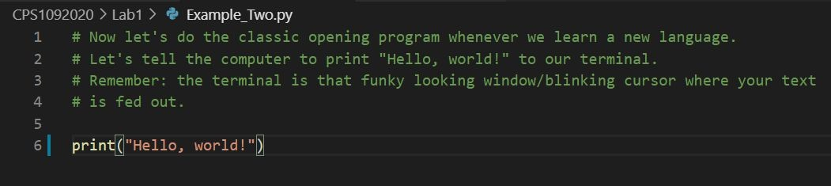
“Hello World” Example

Slide 18
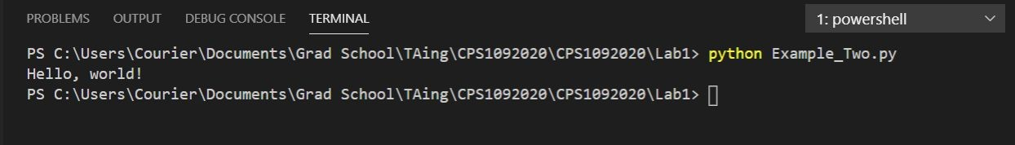
“Hello World” Output

Slide 19
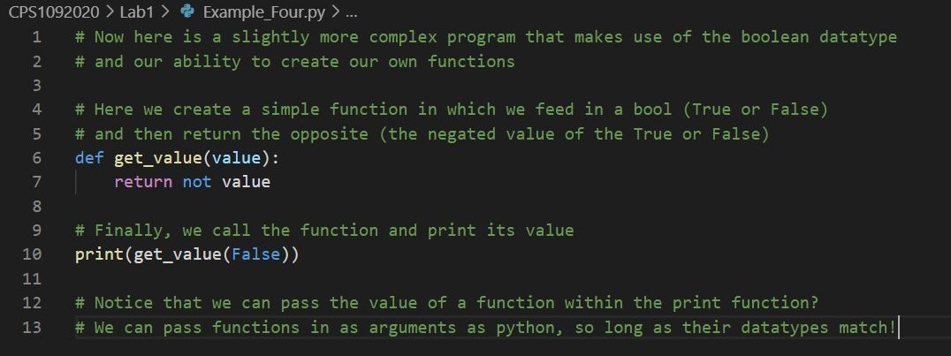
Def Function Example

Slide 20
The Anatomy of a Function
Recall the function from the previous slide:
def is a keyword that indicates the beginning of a function
get_value is the name of this function
value is the input to this function. Any variables you want to use within the function should be here. You can have multiple variables, separated by commas
e.x. (value_1, value_2, value_3)
def get_value(value): return not value
notice the indentation. Much like with if statements everything within the function should match its indentation level (or be further right, if there are internal colons)
don’t forget the colon!
return will exit the function, and the output will be whatever variable follows the keyword return. In this case, if you call the function with get_value(False) , your output will be: True

Slide 21
The Anatomy of an “if” Statement
“if” statements are an extremely useful part of most programming languages, and are vital for most programs Consider the following example:
x = 3 # Declaring the variable x to be equal to 3
The syntax is as follows:
if (x == 3):
print(“x is equal to 3”)
if/elif/else (condition):
things to do if condition is True more things to do if condition is True
things that will happen regardless
if (x <= 2):
print(“x is less than or equal to 2”) elif (x == 4):
print(“x is equal to 4”) else:
print(“x is greater than 2 but not equal to 4”) if (x == 3):
print(“and x is equal to 3!”) print(“FIN”)
Notice: indentation, the colon
Example output:
x is equal to 3
x is greater than 2 but not equal to 4 and x is equal to 3!
FIN

Slide 22
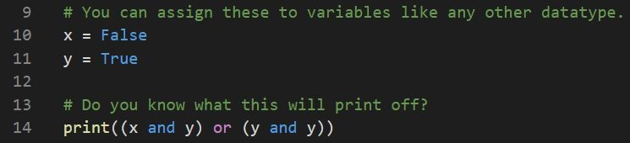
Logic Example

Slide 23
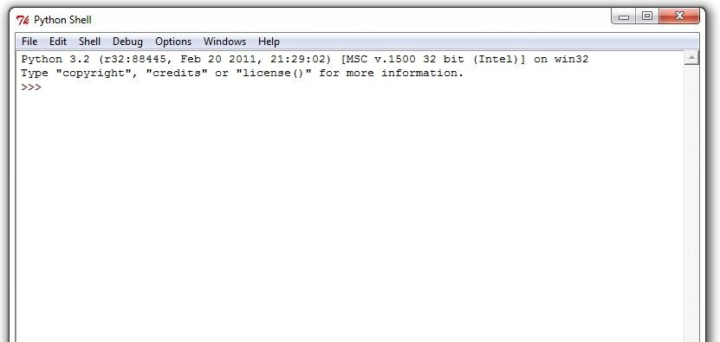
Writing in the Shell
The shell is that funky text area where you can type things in your IDE(or if you’re using a terminal, the weird prompt that comes up when you type “python”). It looks like this:

Slide 24
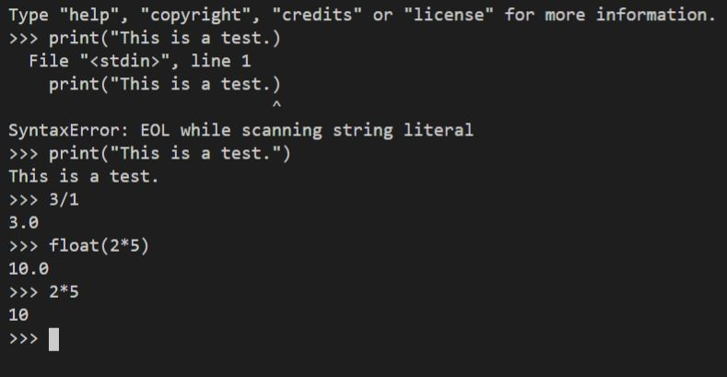
Writing in the Shell

Slide 25
Contact Us
If you have any questions regarding the course content / structure / etc. (and your question is not answered by the CMF) please reach out to us at:
Gurpreet Kaur : gurpreetkaur.kaur@torontomu.ca
Mojan Nooshin :mnooshin@torontomu.ca
Course GitHub (this section):
https://github.com/ChrisKolios/CPS109_Fall2022

